Slide 1
DA101.3 Project: Analyze NYSE Data
Aktolkyn Perritaz
Masterschool Data Analysis
October 10, 2022

Slide 2
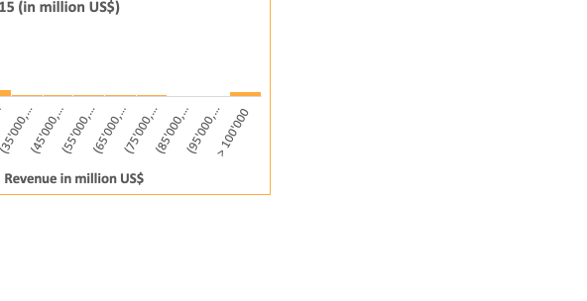
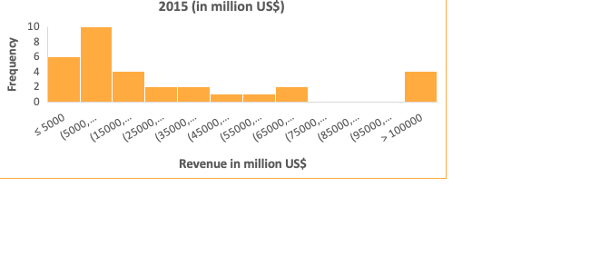
Is the revenue distribution for Consumer Staples and Consumer Discretionary sectors is similar in year 2015?
The histograms show the total revenue for Consumer Staples and Consumer Discretionary sectors reported for all companies in year 2015.
The total revenues for both sectors is around $US 1.4 trillion. However, the mean for Consumer Staples is 2.4 times higher than for Consumer Discretionary (around $US 45 billion vs. $US 19 billion). This is due to the larger number of sector players in Consumer Discretionary.
Both distributions are asymmetric and right-skewed or positively skewed – i.e. the means for both sectors are higher than the medians. However, there are differences in the distribution of revenues among the companies.

Slide 3
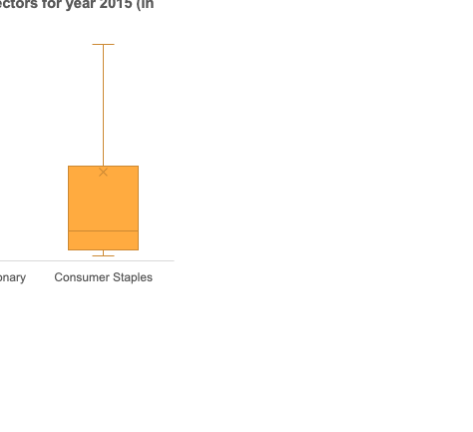
Is the revenue distribution for Consumer Staples and Consumer Discretionary sectors is similar in year 2015?
 | Consumer Discretionary | Consumer Staples
 | Measures of central tendency
Median | 9'474 | 14'985
Mean | 18'649 | 44'787
 | Measures of spread
MIN | 1'492 | 2'723
Q1 | 5'949 | 5'777
Q3 | 16'439 | 47'584
MAX | 152'356 | 485'651
Range | 150'864 | 482'928
IQR | 10'490 | 41'808
Outlier -lower limit | -9'786 | -56'935
Outlier - higher limit | 32'174 | 110'295
Standard deviation | 28'247 | 88'732
The median for Consumer Staples is 1.6 times more than for Consumer Discretionary (around $US 15 billion vs. $US 9.5 billion). The standard deviation for Consumer Staples is 3 times more than for Consumer Discretionary (around $US 89 billion vs. $US 28 billion), reflecting higher variability of revenues of companies in Consumer Staples than in Consumer Discretionary. The range in Consumer Staples is 3.2 times more than for Consumer Discretionary (around $US 483 billion vs. $US 152 billion), it also indicates that the revenues are more spread out in Consumer Staples. This finding is confirmed by the IQR, which excludes the effect of higher outliers, IQR in Consumer Staples is 4 times more than for Consumer Discretionary.

